Slide 1
Science Technology Park
…research, development, innovation, entrepreneurship
Dr. Stelios Himonas
Permanent Secretary
Ministry of Energy, Commerce, Industry & Tourism
Republic of Cyprus
24 November 2015

Slide 2
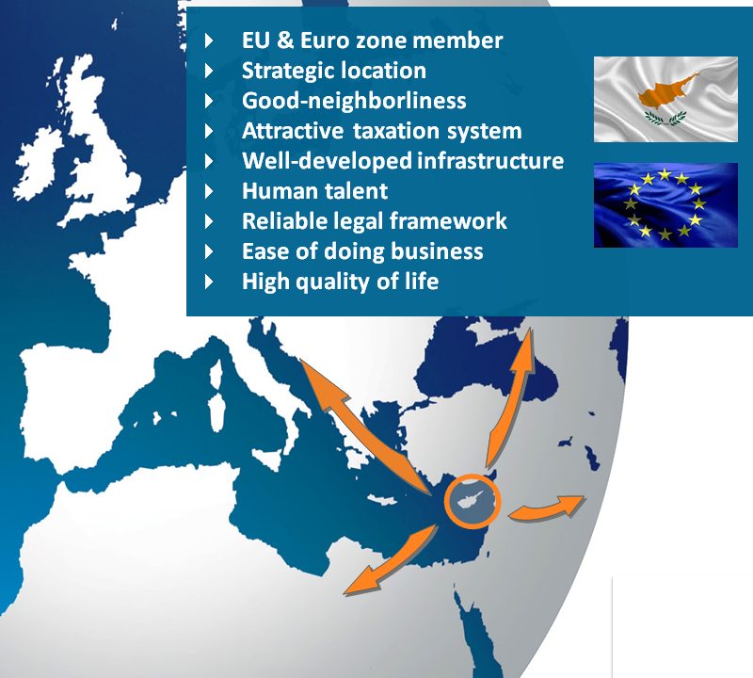
Potential
limited natural resources and low heavy industry potential
At a unique location
EU MS → stable and
predictable environment
High standard of living
Excellent services
Attractive tax system
Human capital
…but
Innovation and entrepreneurial potential

Slide 3
Potential for Israel
Access to EU funds
Joint proposals Horizon 2020
CYP gateway to neighboring countries
CYP – ISR Collaboration
Student exchange programs
Technical dialog of industries
Exchange of knowledge/technology in RES & Energy Efficiency

Slide 4
Vision / Strategic Objective
transforming Cyprus into a regional center for applied research, innovation, technology and entrepreneurship

Slide 5
Entrepreneurship/Innovation Ecosystem in Cyprus
Entrepreneurship and Innovation
Main pillars of new Growth Strategy
National Policy statement for the improvement of the Entrepreneurial Ecosystem of Cyprus
Short
Targeted
Concrete measures

Slide 6
Ecosystem - Objectives
Improve entrepreneurial culture and skills
Increase number of new, innovative, high-value added enterprises
Improve competitiveness and sustainability of businesses
Promote internationalization of Cypriot enterprises

Slide 7
Ecosystem – Initial Actions
Establish Entrepreneurial Center
Information on all available funding resources
Facilitation of business activity – One Stop Shop
Mentoring services
Develop a Science and Technology Park

Slide 8
STP - Tenants
Research Centers
Hi tech companies
Start-ups
other knowledge based organizations

Slide 9
General Framework
use of State owned land
50 year Land Lease Agreement
strategic investor through tender procedure
experience and knowhow
financial capability
incentives package

Slide 10
Incentives Package
Financial
rent payment after 5 years
up to €3 mln rent reduction
Tax
Town Planning
Work Permits
RES Plant

Slide 11
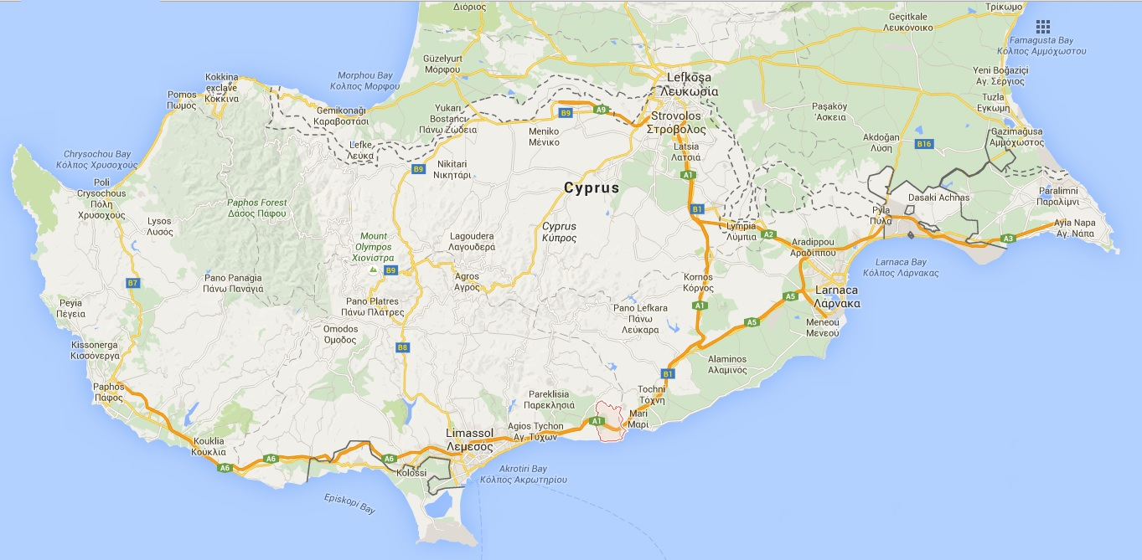
Location
65km
50km
16km
Pentakomo

Slide 12
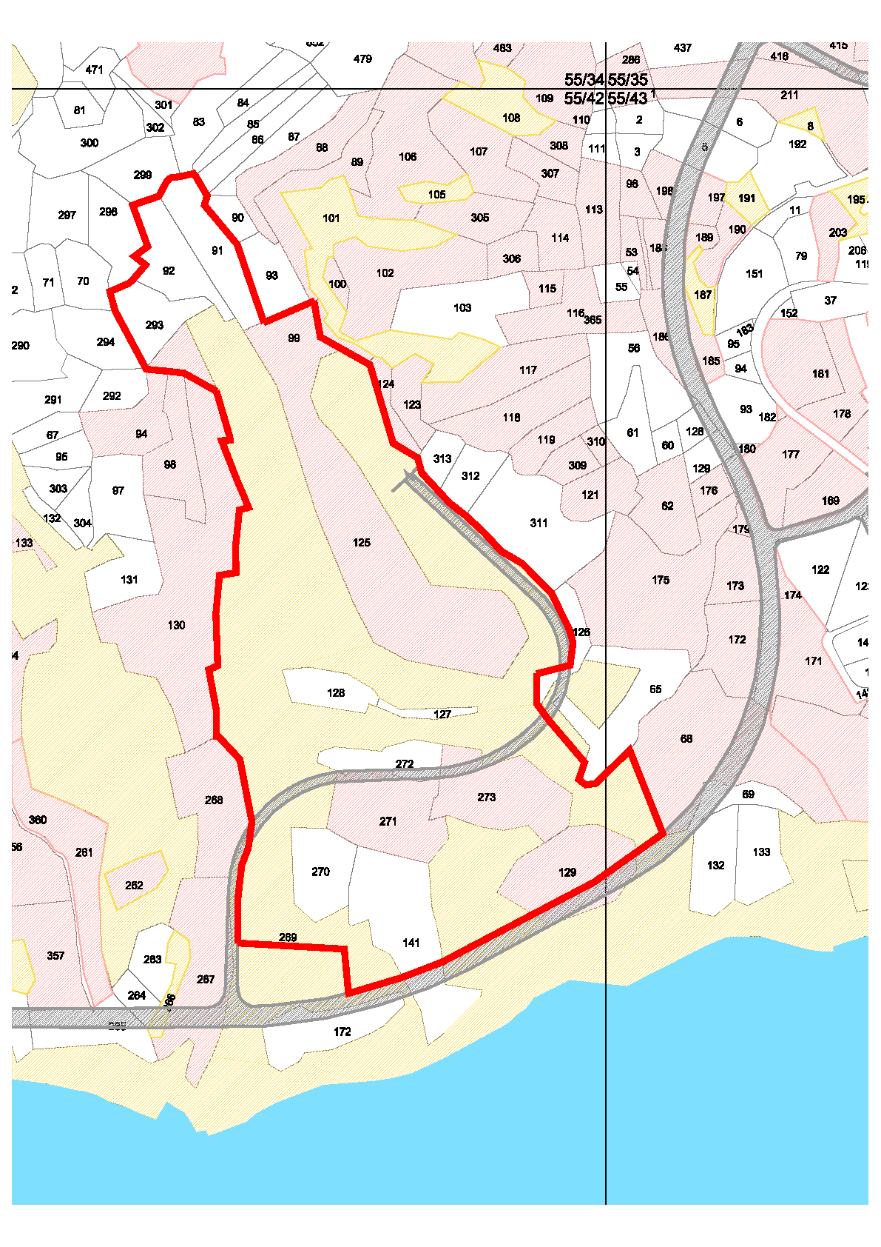
Location (2)
RES Power Plant
Energy Storage
Total area ≈ 340 000 m²
Land expropriated

Slide 13
Planning Framework
Building ratio up to 45%
2-3 floors (more possible)
Small hotel - up to 100 rooms
Green areas - 15% of total area
Conference & Exhibition Center
Other facilities (housing, recreational, cafeteria, etc)

Slide 14
Land Lease Agreement
Right to possess, use, administer, manage and operate the STP
Right to mortgage
Strategic Investor is entitled to rent or lease
buildings (or space) to tenants
land to tenants to build on their own expense buildings and/or infrastructure for their own exclusive use

Slide 15
Operation
Commencement date – within 5 years from the date of signing the Land Lease Agreement
Phased development allowed

Slide 16
Obligations of the Government
Construction of public road - sidewalks and lighting
Electricity infrastructure
Telecommunications infrastructure
Water supply – potable, irrigation purposes
Obligations fulfilled within 18 months

Slide 17
Tender Procedure
RFP
In November
4 months to submit proposals
Eligibility for participation
legal entity - also consortium
Double participation not allowed
and
≥ 1 STP (participation ≥ 30%)
or
≥ 2 large scale construction contracts (participation ≥ 30%)
≥ 10 yrs of experience in operating STPs

Slide 18
Tender Procedure (2)
Technical Requirements (Business Plan)
Master Plan of project
Development time schedule
Description of permits/licenses
Risk assessment of factors which may affect the smooth implementation of the contract scope
Demonstrate financial resources

Slide 19
Tender Procedure (3)
Financial Offer
Lump sum – indicating payment schedule
Annual installments
Combination of above

Slide 20
Tender Evaluation
Qualification Adequacy - pass or fail
Eligibility for Participation
Technical Requirements
Consider Financial Offers of those passed
Successful Bidder → highest financial offer
NPV will be considered for evaluation
Negotiations of the Land Lease Agreement is possible on non-critical aspects

Slide 21
Thank you for your attention
Tel. + 357 22 867233
perm.sec@mcit.gov.cy
www.mcit.gov.cy

